Slide 1
Song Popularity Prediction
DA-224-O Mini Project 2
Team -

Slide 2
01
Introduction
Table of Contents
02
Solution Overview
03
E2E ML Process
04
Conclusion
Data Analysis
Feature Engineering
ML Modelling
Evaluation

Slide 3
Introduction
Problem Overview
“When working with data, I discover what I really want to say.”
—Damian Mingle

Slide 4
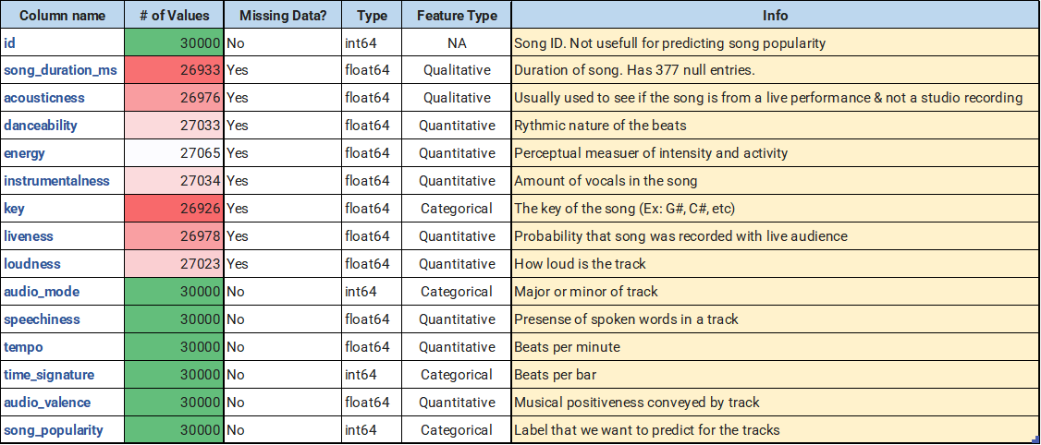

Introduction
Predicting a song whether it is popular or not based on 13 audio features of the track
One of the widely discussed classification problems on the Internet
Understanding your data set is vital for any ML problem
Plenty of options for choosing the algorithm
Engineering the best approach using ML Concepts

Slide 5
Solution Overview
Executive Summary of Our Approach

Slide 6

Overview Diagram
Pre-Processing
Modelling
EDA
Imputation
Feature Engg
Standard Scaler
OHE
Polynomial Feat.
Correlation
Multicollinearity
Mutual Info
Skewness
Simple Imputer
KNN Imputer
Iterative Imputer
Bfill/Ffill
Tuning, CV
Ensembling
Evaluation
Gridsearch
Cross-Validation
Repeated
Stratified
Split-Modeling
Hard/Soft Voting
Bagging/Pasting
F1
AUC
Accuracy

Slide 7
15+
200+
Distinct ML models
Experiments
0.577
Best AUC achieved
1
Kaggle Leaderboard position(private)

Slide 8
Data Analysis
EDA, Type Conversion, Imputations

Slide 9
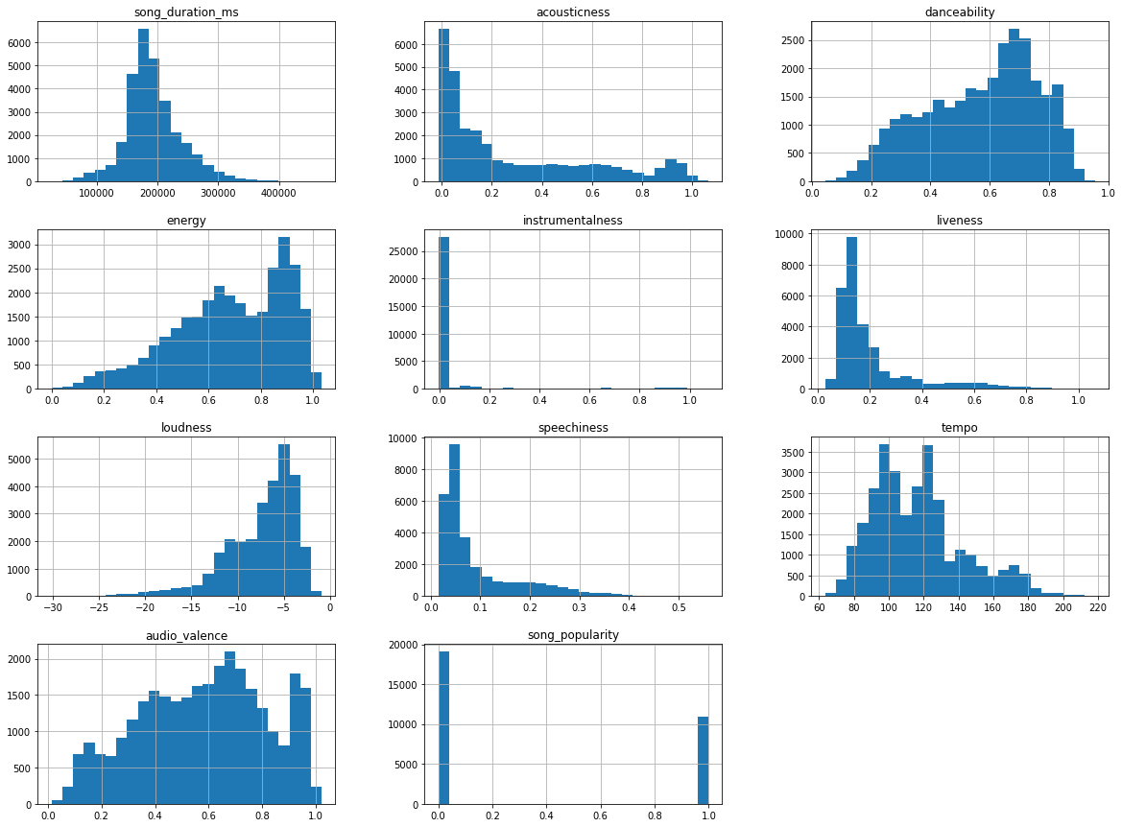
Histograms

Slide 10
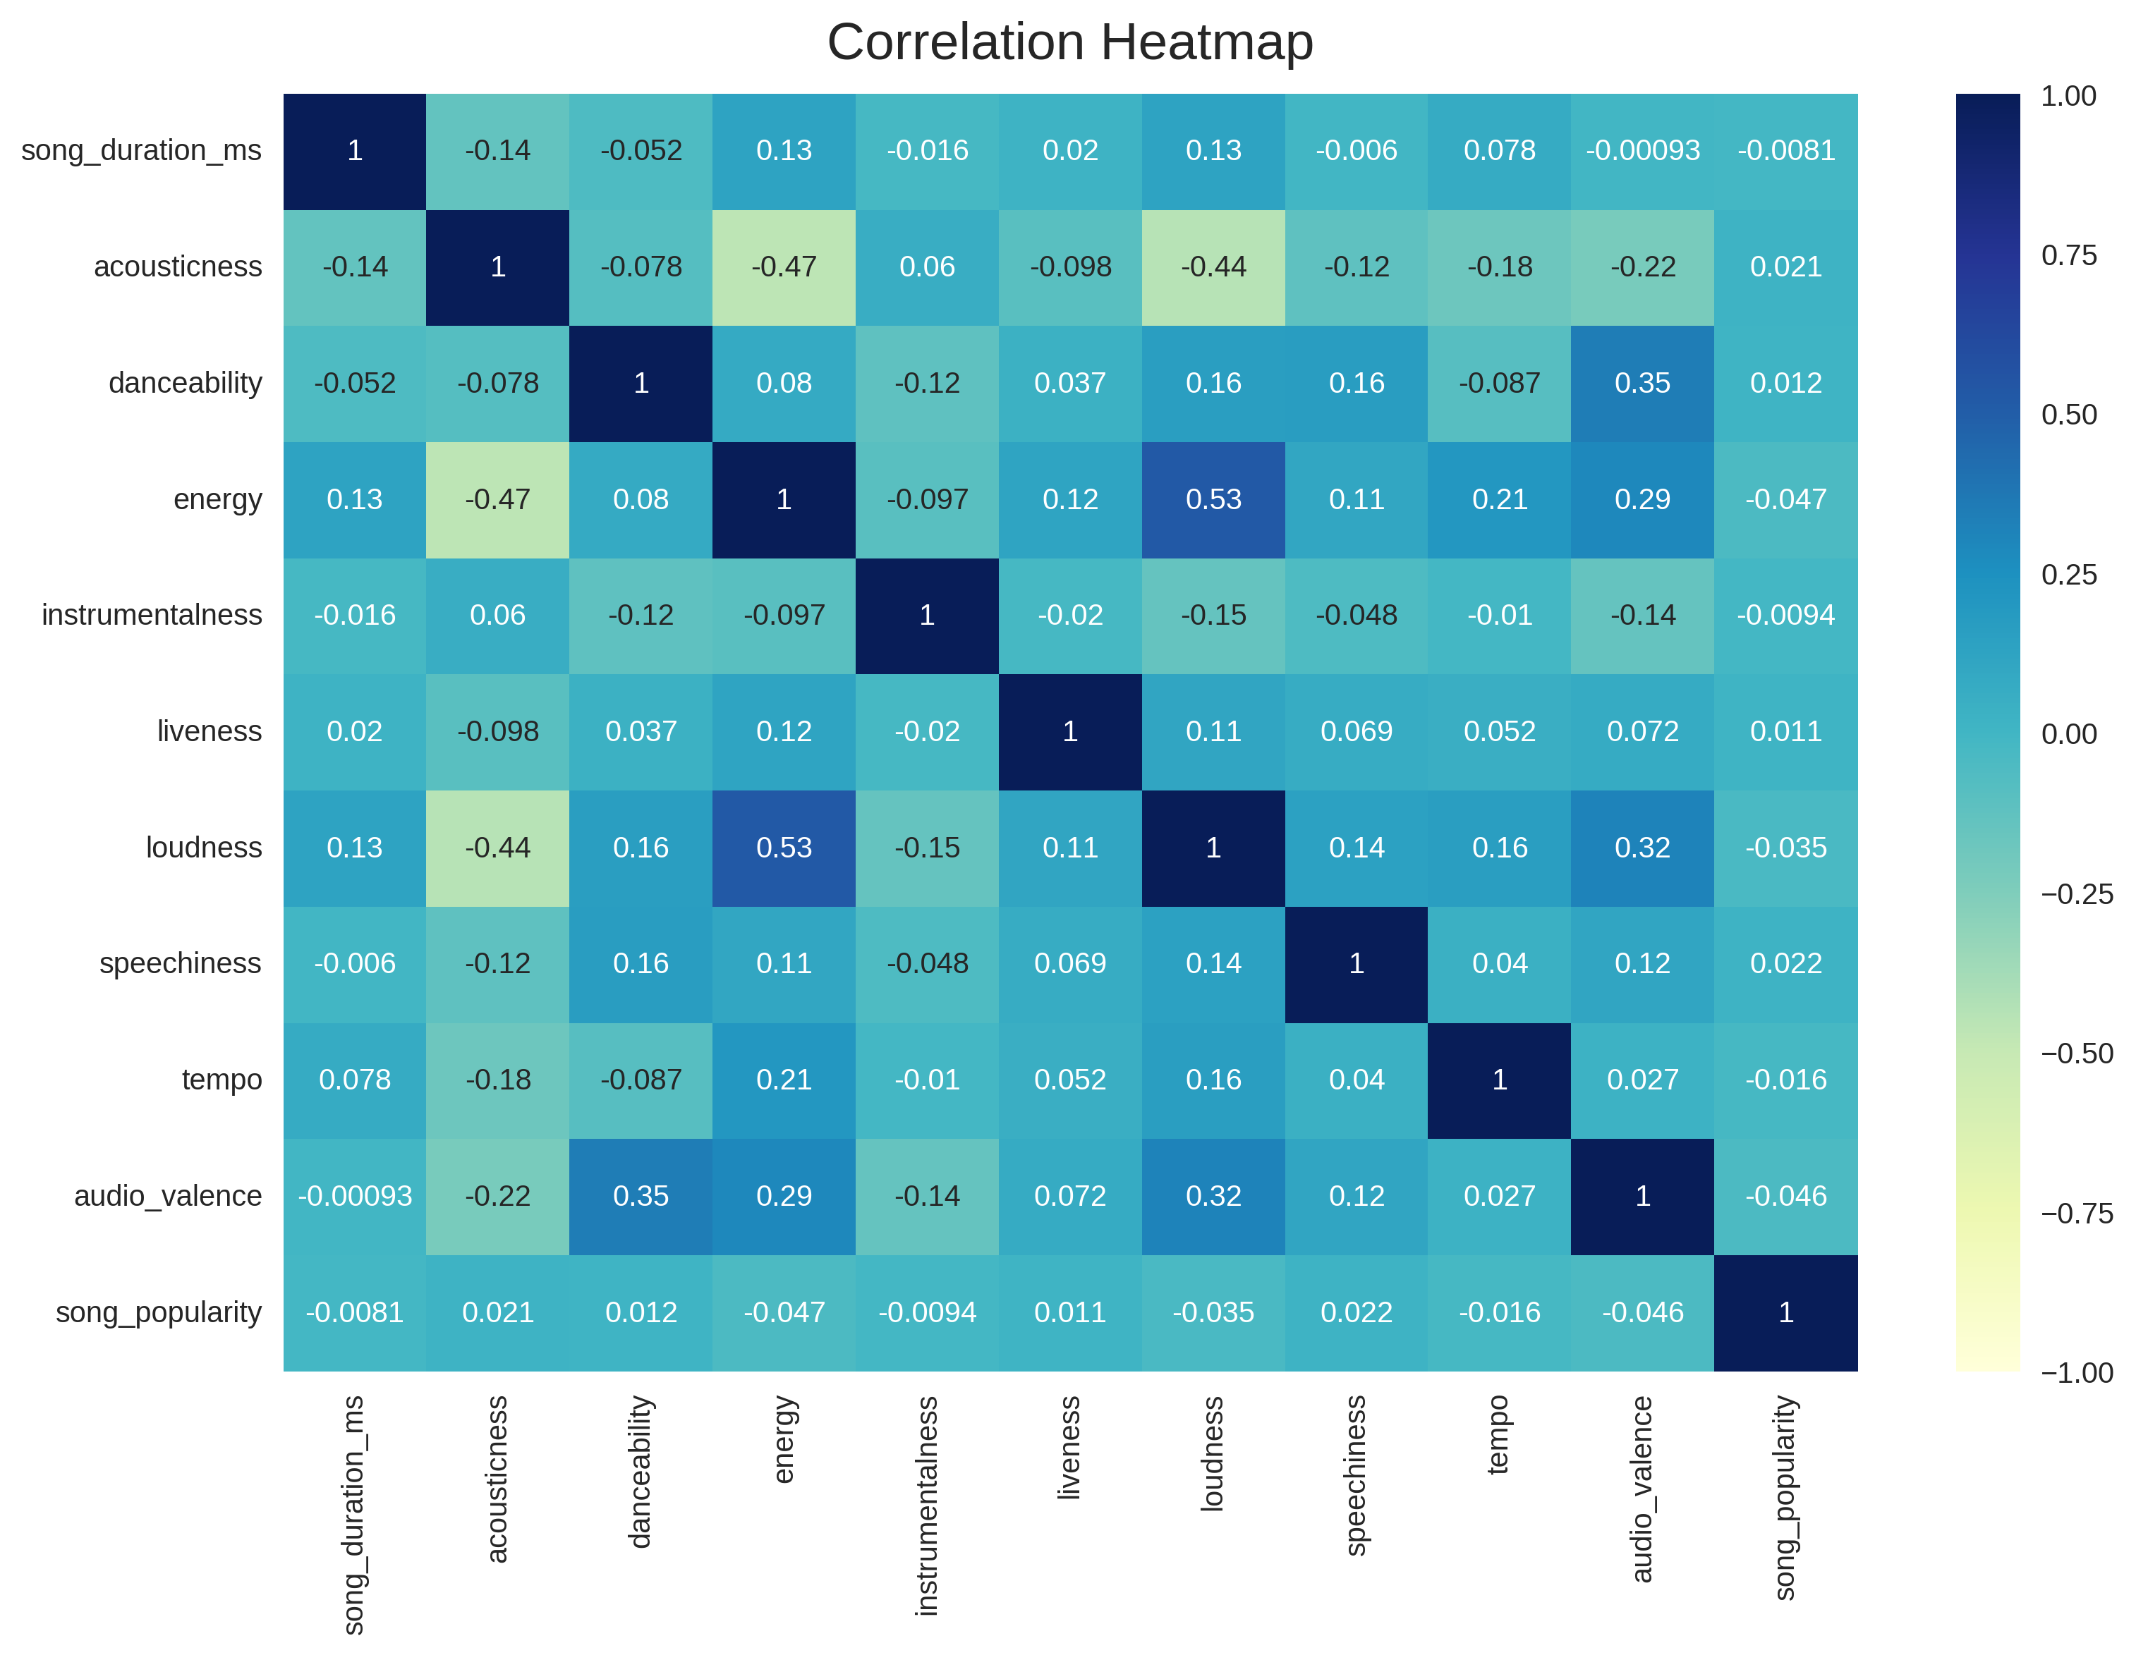
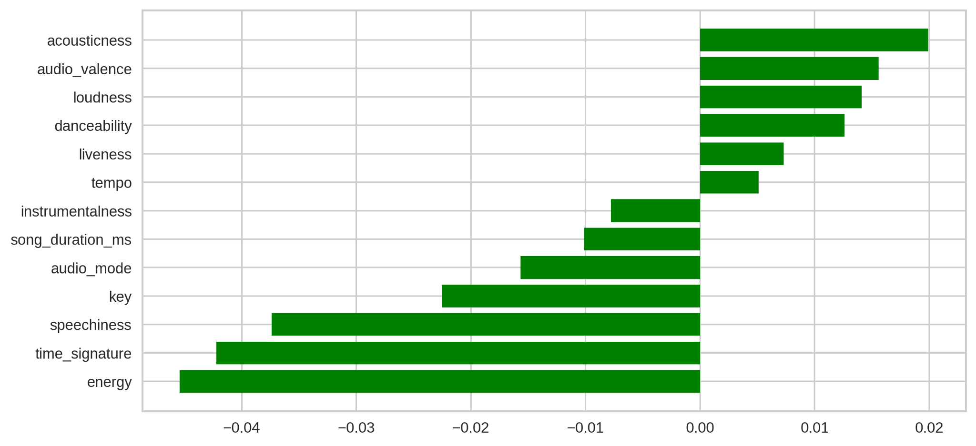
Correlation with Target

Slide 11
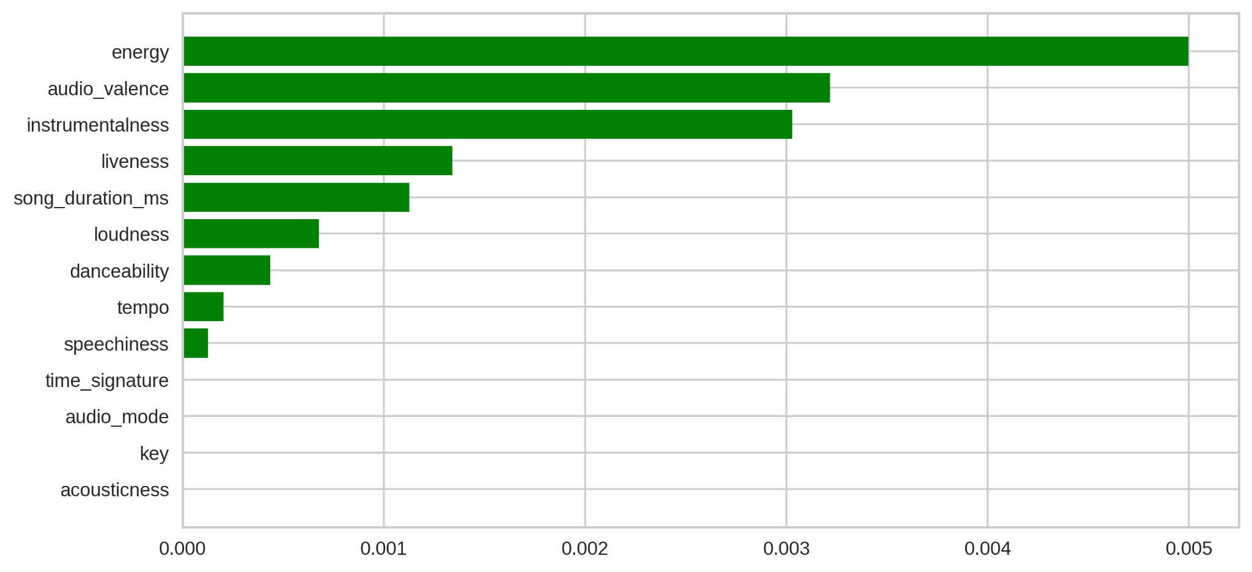
Mutual Information

Slide 12
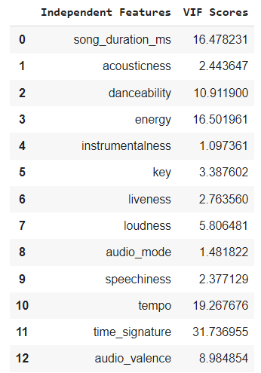
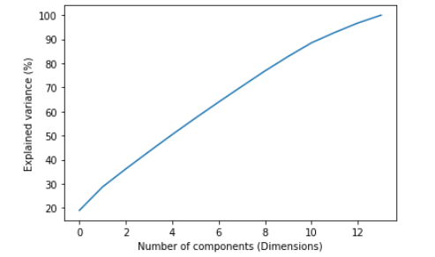
Multicollinearity

Slide 13
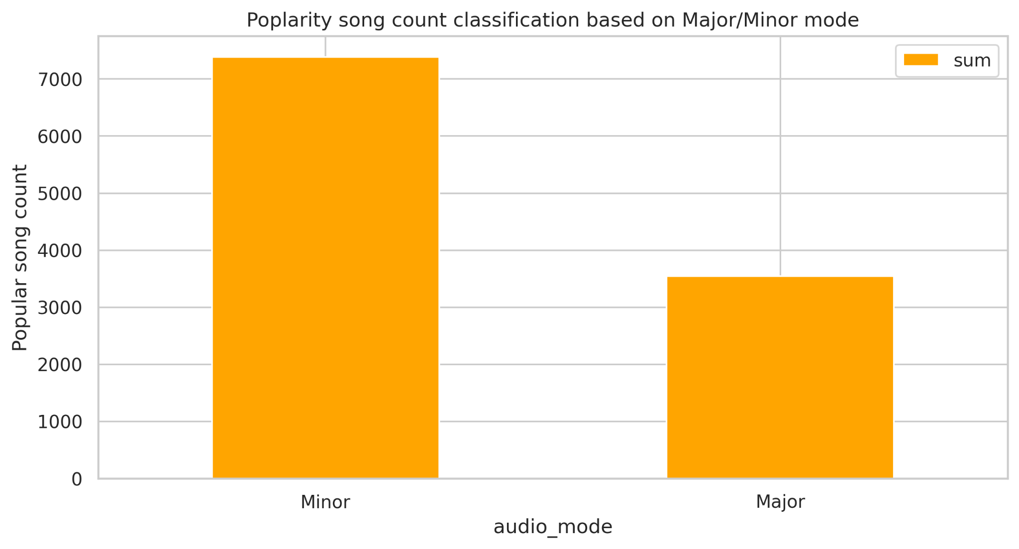
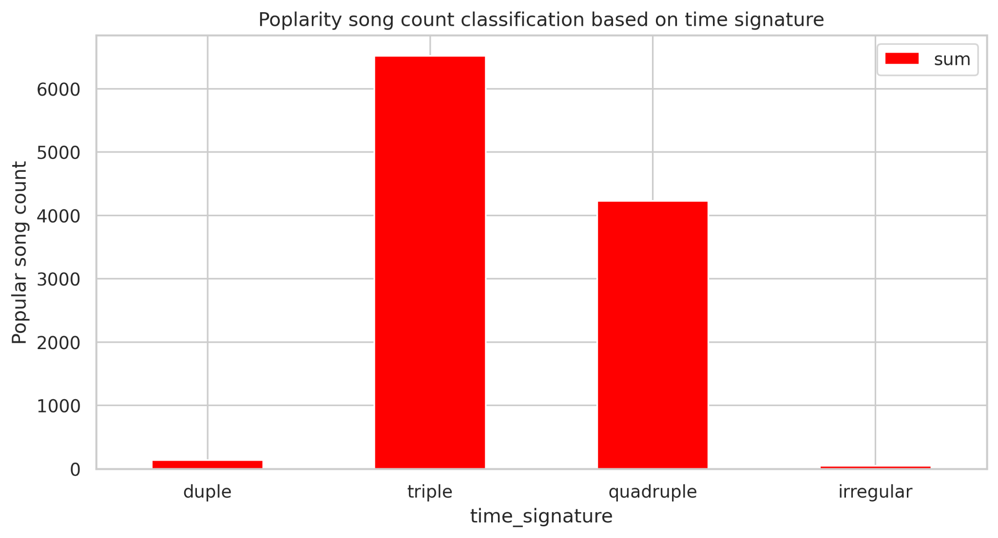
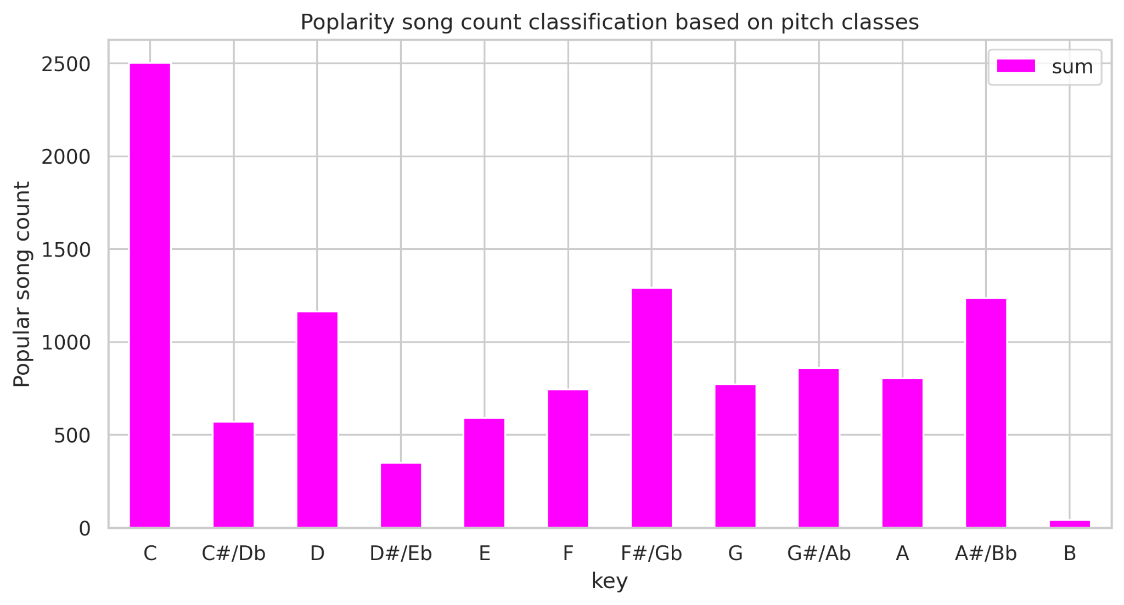
Splits and Stratification

Slide 14
Imputation Overview
Observations: There are 8 features with missing values.
7 Numerical and one categorical feature
3 of them are highly skewed features (non-normal)
Approach: includes the following techniques
Try with SimpleImputer, KNNImputer, IterativeImputer with LR and CB
Separate techniques for Cat and Num features, highly skewed features and the rest

Slide 15
Imputation Result
Evaluation: Compare the Imputation technique with Logistic Regression and CatBoost Models.
Metric: ROC | LogisticReg (l2, newton-cg) | CatBoost (Iter=100, dep=5) | Remarks (Configuration)
SimpleImputer | 0.4995 | 0.5206 | Median for num, Most frequent for cat
KNNImputer | 0.5008 | 0.5269 | Tried N from 1-10, N=3 is the best
IterativeImp+ MF | 0.5001 | 0.5183 | MF- Most Frequest for Cat Cols
KNN + MF | 0.5001 | 0.5147 | KNN with N=3, MF for Cat Cols
KNN + It + MF | 0.5009 | 0.5109 | Iterative for Skewed Cols

Slide 16
Feature Engineering
Polynomial Features, Split-based Modelling, Stratification

Slide 17
Scaling, Encoding, Other transformations
Approach: includes the following techniques
Scalers: StandardScaler, MinMaxScaler
Encoders: OHE, LabelEncoder/OrdinalEncoder
Power transformation, functional transformation
We chose StandardScaler for numerical columns and OHE for categorical columns in the final model.

Slide 18
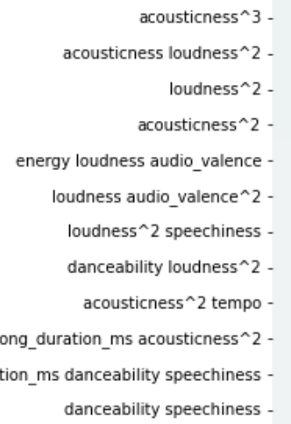
Polynomial Features
Approach:
We trained our models with three levels of Polynomial Features
Level: 0 - features in their original form
Level 2 and 3 - features combined at the max degree of 2 or 3
Result:
We found only slight improvement by using polynomial features over original features in linear level
Without polynom features, max collinearity with target = 0.022
With polynomial degree 2 collinearity increased from 0.022 to 0.032
With polynomial degree 3 it increased to 0.037

Slide 19
Split Modelling, Stratification
We found the following features have skewed distribution of data around some range of values:
Instrumentalness <= 0.002,
Liveness: liveness >= 0.1 and liveness <= 0.2,
Audio_mode: audio_mode == 1,
Time_signature: time_signature == 4
We tried split based modelling on all these features. We separated out the data into two classes, (i) they belong to the skewed range (ii) they fall outside it.
Feature split of Instrumentalness and Liveness give better results over others
We also tried stratified sampling using the above-mentioned features due to their skewed distribution. However, it did not help in improving the AUC Score.

Slide 20
ML Models
Logistic Regression, Decision Tree, Random Forest, SVM, CatBoost, AdaBoost, XGBoost, LightGBM, ExtraTrees, GBClassifier, KNClassifier, TabNet

Slide 21
ML Modelling Process
1. Choose Model
3. Cross-Validation
4. Ensembling
Experimented with 15+ models. WIth Data splits, Stratifications
Avoid overfitting by Stratified data splits
KFold
Combine the best models for better result
2. Grid Search
5. Evaluation
Choose the right hyper params and run GridSearch
Use F1 as the metric for choosing the best model

Slide 22
Model Evaluation (1/3)
KNNImputer(3), StdScaler, OHE | Best Parameters (Grid-Search Output) |  | AUC (on Validation)
Logistic Regression | C=100, penalty=L2 |  | 0.5010
CatBoost Classifier | ‘depth': 2, 'iterations': 100, 'learning_rate': 0.5, 'l2_leaf_reg': 0.5 |  | 0.5117
LightGBM | [Iterative Imputer with random state 42] |  | 0.5708
LightGBM | [KNN Imputer with N=2] |  | 0.5731
AdaBoostClassifier | 'base_estimator__max_depth': 10, 'base_estimator__min_samples_leaf': 10, 'learning_rate': 0.1, 'n_estimators': 50 |  | 0.5165
TabNet | optimizer_fn=torch.optim.Adam, lr=2e-2, scheduler_params={"step_size":10,"gamma":0.9} |  | 0.5256

Slide 23
Model Evaluation (2/3)
KNNImputer(3), StdScaler, OHE | Best Parameters (Grid-Search Output) | AUC (On Validation)
Decision Tree | {'max_depth': 5, 'max_features': 'log2', 'min_samples_leaf': 1, 'min_samples_split': 2, 'splitter': 'best'} | 0.5019
Random Forest | {'class_weight': 'balanced', 'max_depth': 20, 'max_features': 'log2', 'min_samples_leaf': 80} | 0.5315
SVC RBF | 'C': 0.1, 'gamma': 0.5, 'kernel': 'rbf', 'max_iter': 10000, 'probability': True | 0.5
SVC Poly | 'coef0': 1, 'degree': 3, 'kernel': 'poly', 'max_iter': 10000, 'probability': True | 0.4959
SVC Linear | 'C': 0.1, 'kernel': 'linear', 'max_iter': 10000, 'probability': True | 0.5

Slide 24
Model Evaluation (3/3)
KNNImputer(3), StdScaler, OHE | Best Parameters (Grid-Search Output) | AUC (On Validation)
GradientBoostingClassifier | n_estimators=64, learning_rate=0.8 | 0.5099
KNN Classifier | n_neighbors=13 | 0.5190
XGBClassifier | 'booster': 'gbtree', 'eval_metric': 'logloss', 'max_depth': 30, 'n_estimators': 10, 'tree_method': 'hist' | 0.5154
ExtraTreesClassifier | {'class_weight': 'balanced', 'max_depth': 30, 'max_features': 8, 'min_samples_leaf': 80} | 0.5301

Slide 25
Split-based Models
Features used for Model-split | ML Model |  | AUC (On Validation)
Time signature | CatBoost (iterations=100, learning_rate=1, depth=5) |  | 0.5044
Liveness | CatBoost (iterations=100, learning_rate=1, depth=5) |  | 0.5152
Audio mode | CatBoost (iterations=100, learning_rate=1, depth=5) |  | 0.5084
Instrumentalness | CatBoost (iterations=100, learning_rate=1, depth=5) |  | 0.5110

Slide 26
Ensembling Overview
Approach:
Tuned models are used with various ensembling techniques.
Multiple models together with Hard/Soft Voting Classifier
Bagging
Pasting
Result:
The results are improving the performance of certain models.
Final result on test data is not better than individual results of Boosting models

Slide 27
Ensembling Result
Method | Candidate Models | AUC (Configuration)
Pasting | Decision Tree | 0.5
Bagging | Decision Tree with OOBE=True oobe_score=0.63633 | 0.5011
VotingClassifier, soft | ADA, GBC, RF | 0.5096
VotingClassifier, soft | RF, SVC, KNC, GaussianNB, CB, BaggingClassifier, XGBC | 0.5158
VotingClassifier, Hard | LR, RF, ADA, GBC, ExtraTree | 0.5188
VotingClassifier, soft | LR, RF, ADA, GBC, ExtraTree | 0.5142

Slide 28
Conclusion

Slide 29
Conclusion
Key Observations:
Features are not correlated well (Pearson Coefficient) with target
Some of the features are highly skewed and hence, it gives opportunity to try split-based models and stratification
Some Features are having up to 10% missing values
There is no high multicollinearity in the feature set
Approach and Output:
Preprocessing - Imputations, Scaling, Conversion, Encoding
Feature Engineering - Polynomial, Split, Stratification
Modelling - Popular classification model, Ensembling, Gridsearch on F1, CV
Boosting models gave best results

Slide 30


Thank You!

